Slide 1


Dr. Babasaheb Ambedkar
Marathwada University,
Aurangabad
Department Of Management Science
Project Name : Conducting EDA On Education Sector
Company Name: Clustor Computing
Project Guide
Dr. Yashwant Waykar
Present By
Vaibhav P Adikane

Slide 2
Exploratory Data Analysis (EDA) • Exploratory Data Analysis (EDA) is analyzing the data using visual techniques. It is used to discover trends or patterns or to check assumptions with the help of statistical summaries and graphical representations. • Detection of mistakes. • Checking of assumptions. • Preliminary selection of appropriate models.

Slide 3
Sprints
Project scope - Researching on the engineering education in Maharashtra
- Project progress flow, user flow, data flow diagrams and features list.
Data Collection - Identify data sources including government databases, college websites, and surveys.
- Collect relevant data such as college information (location, accreditation, infrastructure), student demographics, academic performance, and placement records.
Data Cleaning - Perform data cleaning tasks such as handling missing values, removing duplicates, and standardizing data formats.
EDA - Explore relationships between variables using correlation analysis and scatter plots.

Slide 4
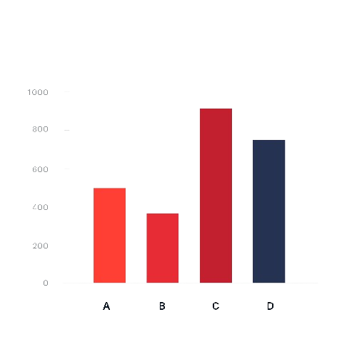
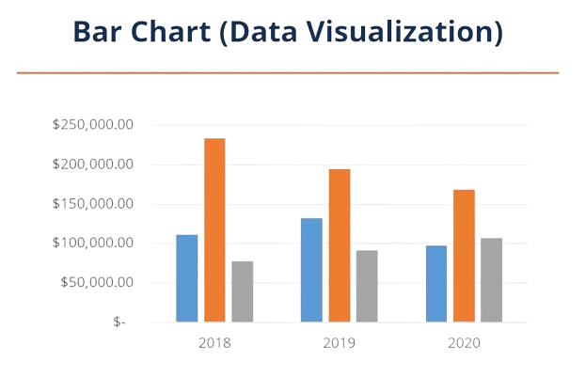
Bar Chart A bar chart or bar graph is a chart or graph that presents categorical data with rectangular bars with heights or lengths proportional to the values that they represent. The bars can be plotted vertically or horizontally. A vertical bar chart is sometimes called a column chart.

Slide 5
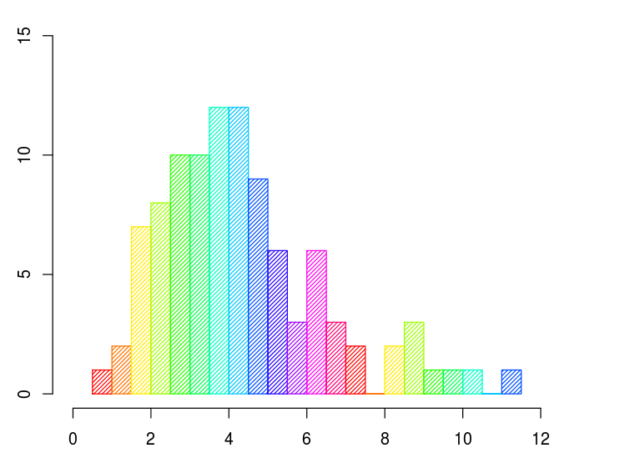
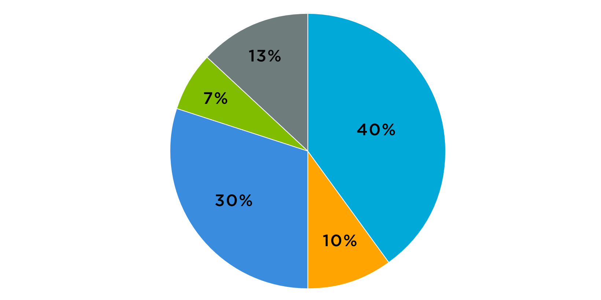
Histogram A histogram is a graph that shows the frequency of numerical data using rectangles. The height of a rectangle (the vertical axis) represents the distribution frequency of a variable (the amount, or how often that variable appears).
Pie Chart A pie chart is used to: Show parts-to-whole relationship Demonstrate each element’s contribution to the whole Compare the contribution of different categories to the whole

Slide 6
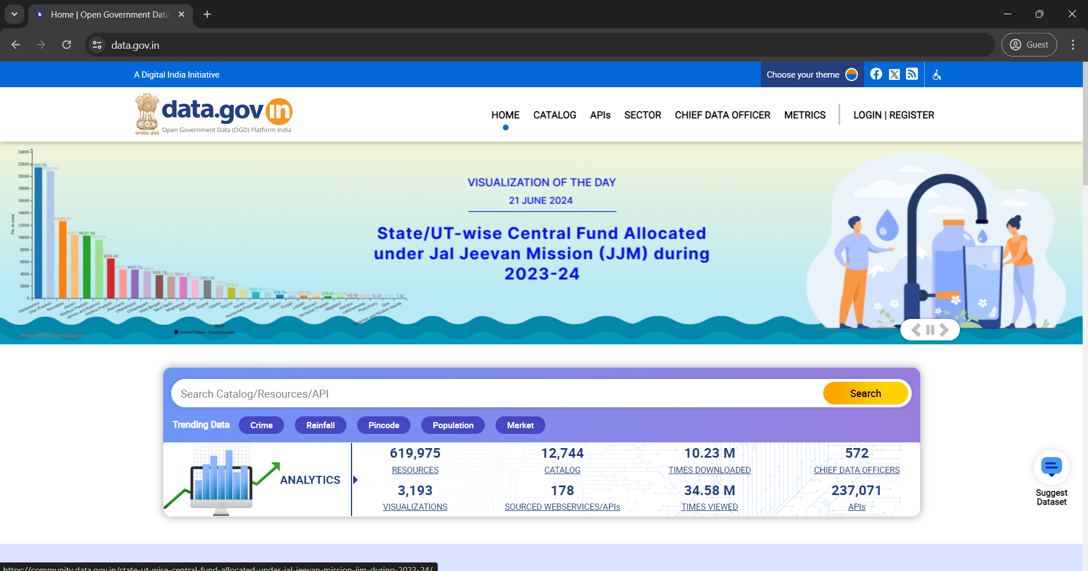
Data Extraction Websites ( From scratch)
Website of data.gov.in

Slide 7
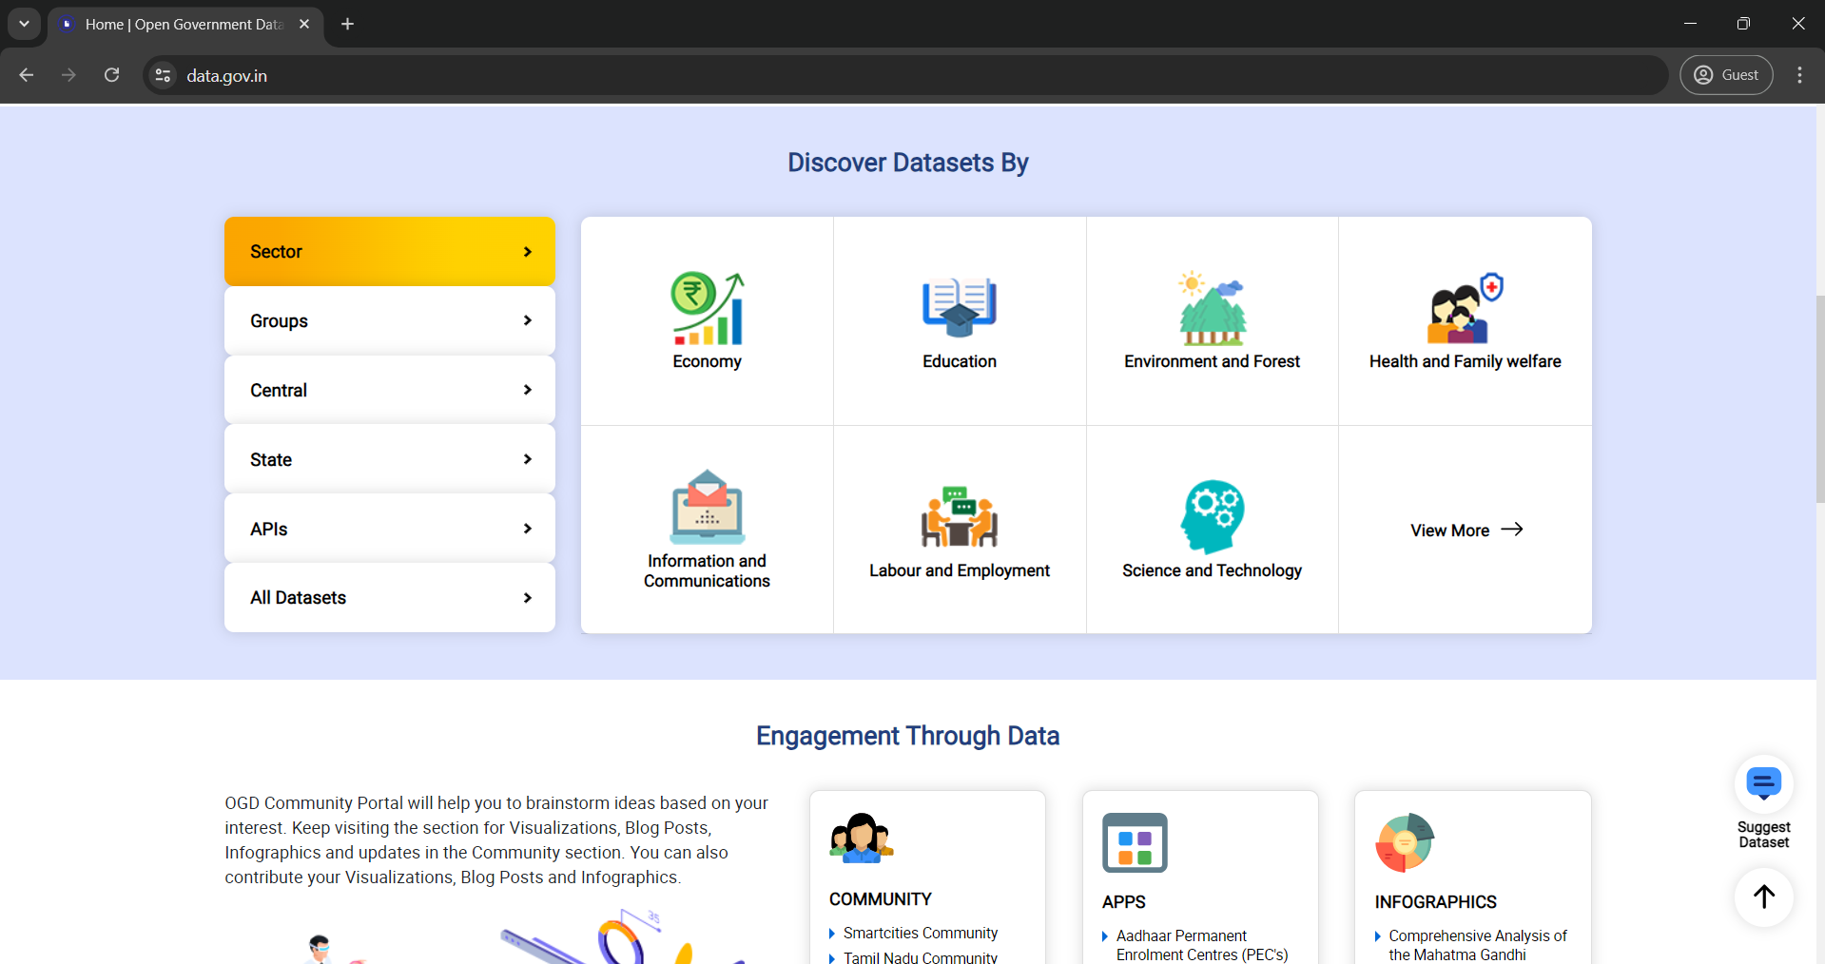
Find dataset By Category

Slide 8
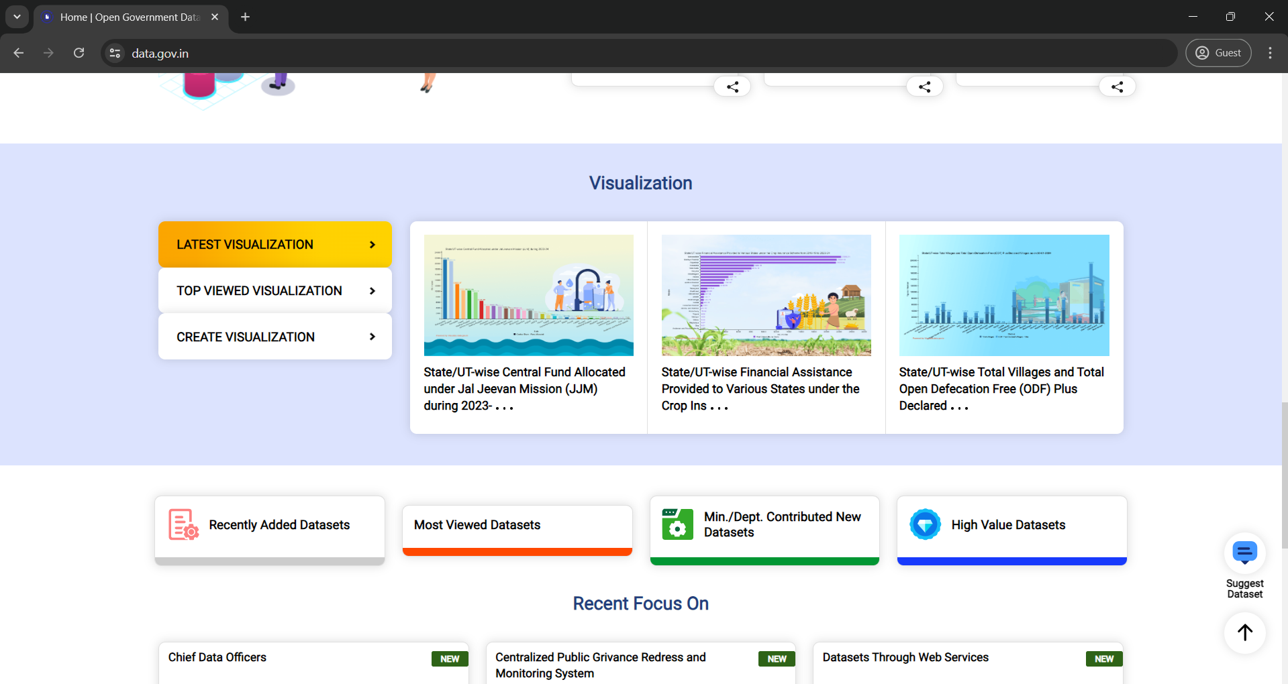
Option for Data Visualization ( optional )

Slide 9
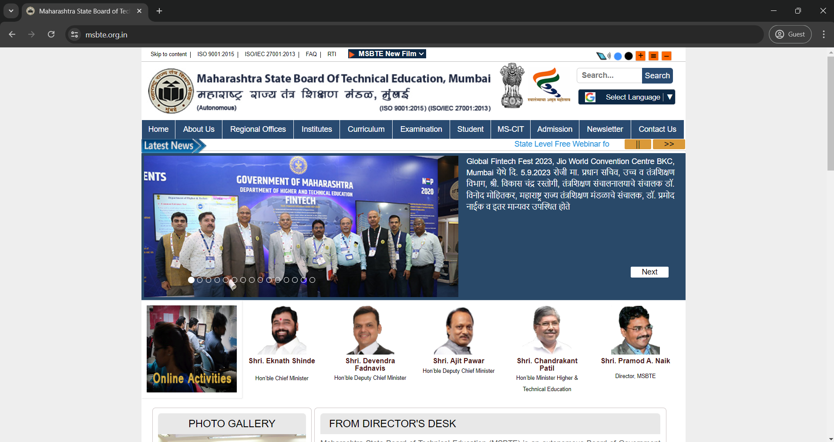
Website of MSBTE

Slide 10
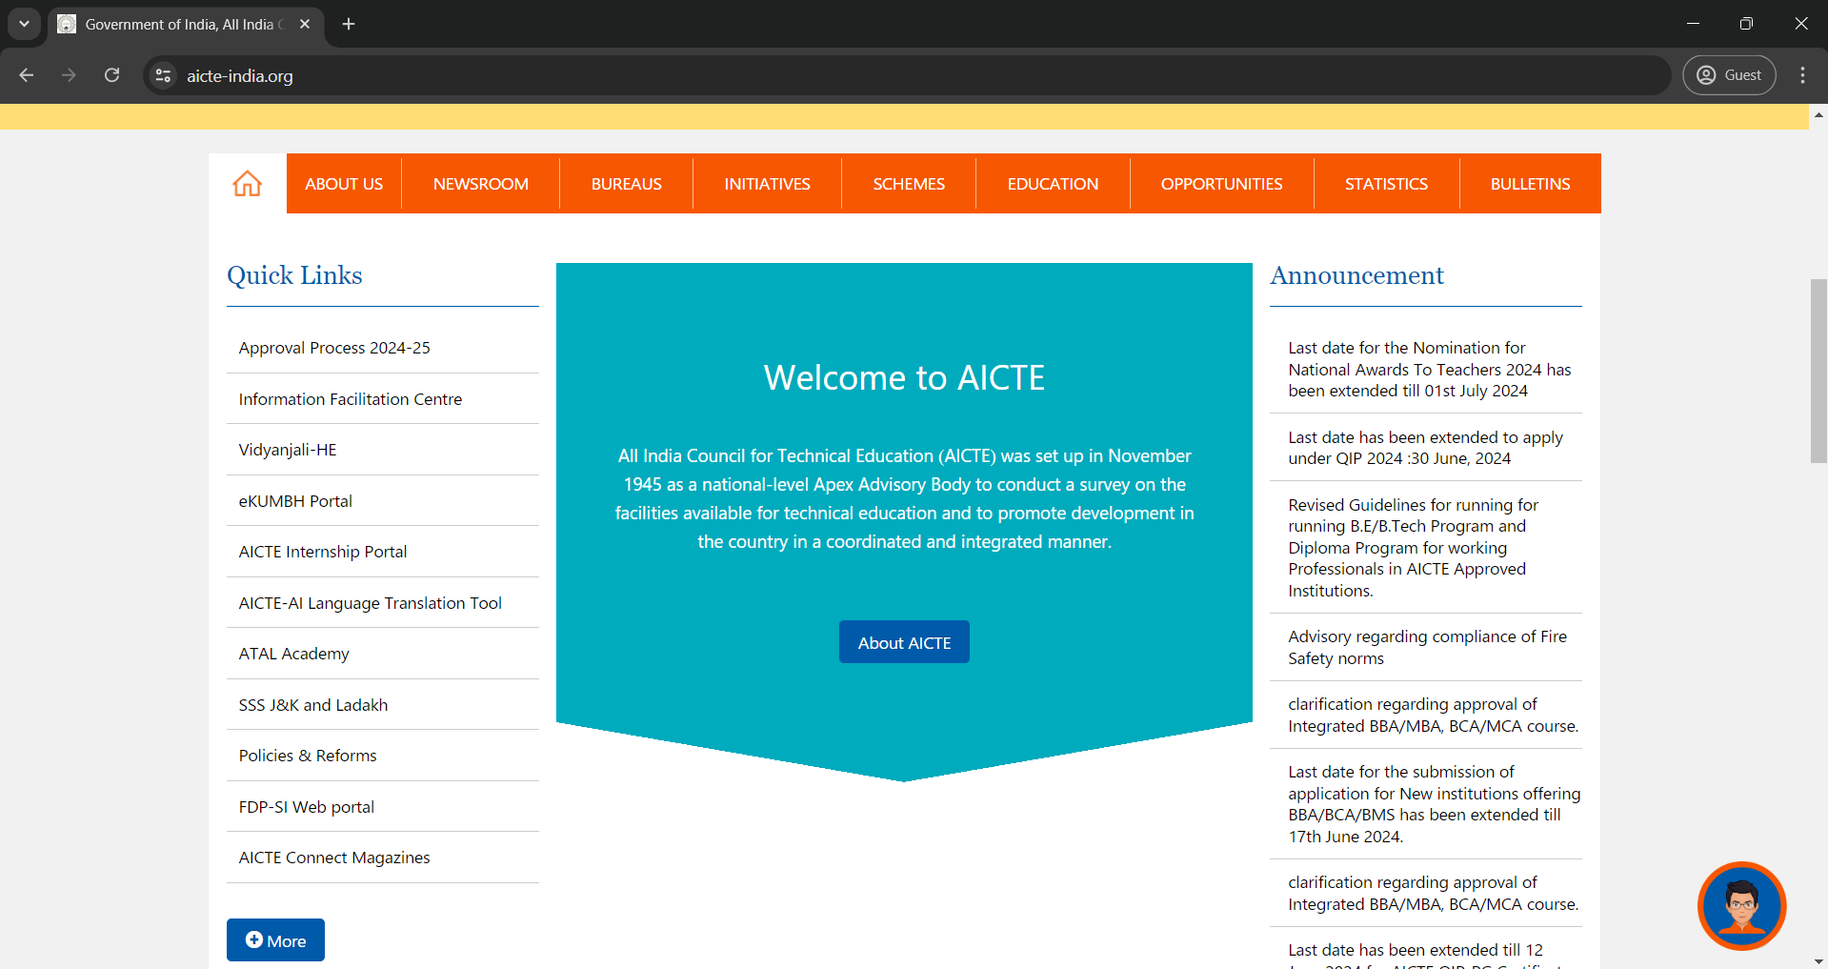
Website of AICTE

Slide 11
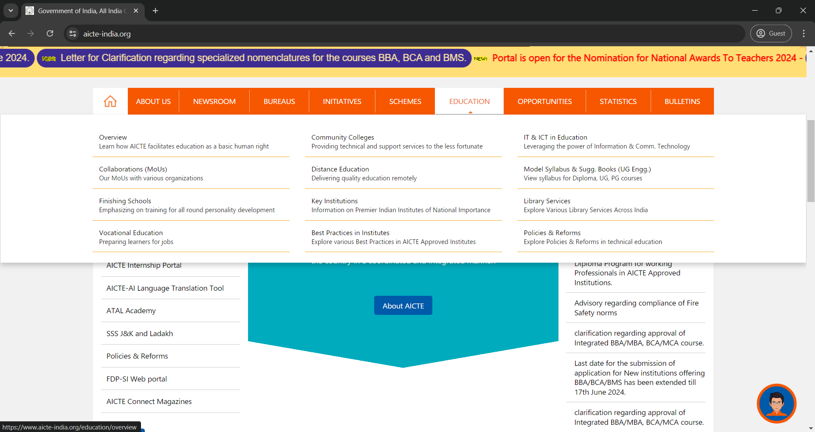
Finding data by category(Education)

Slide 12
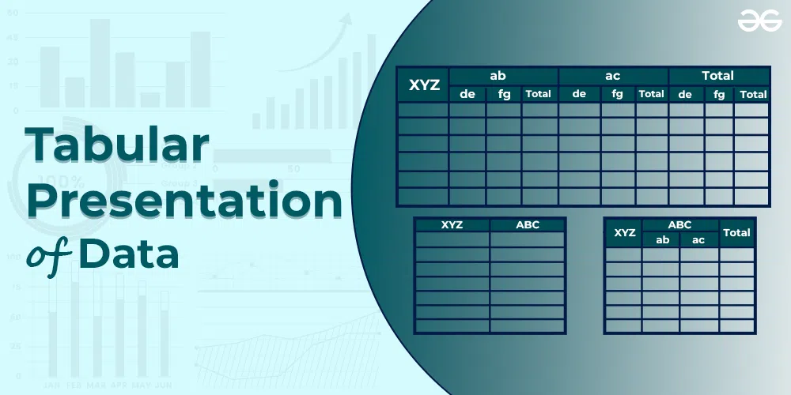
This is Part of Feature List ( off data )

Slide 13
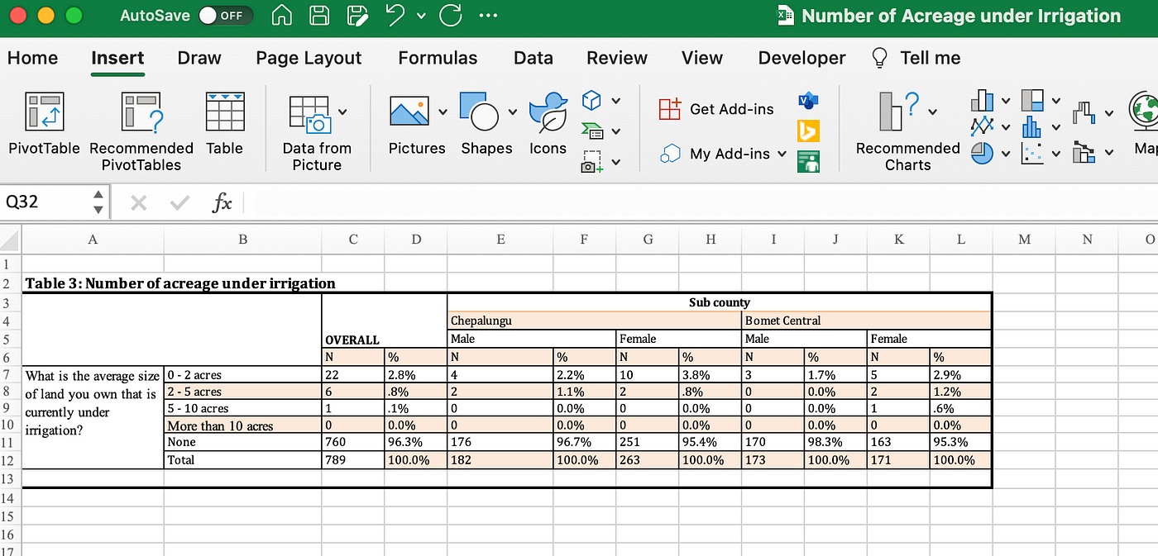
Feature List ( On data Set)
Data Variables
Master Table
On Data Set

Slide 14
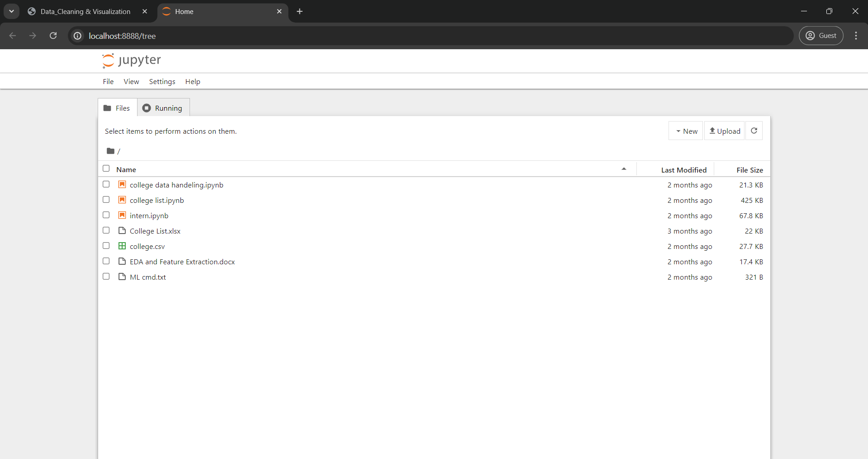
Interface of Jupyter Notebook

Slide 15
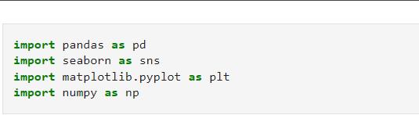
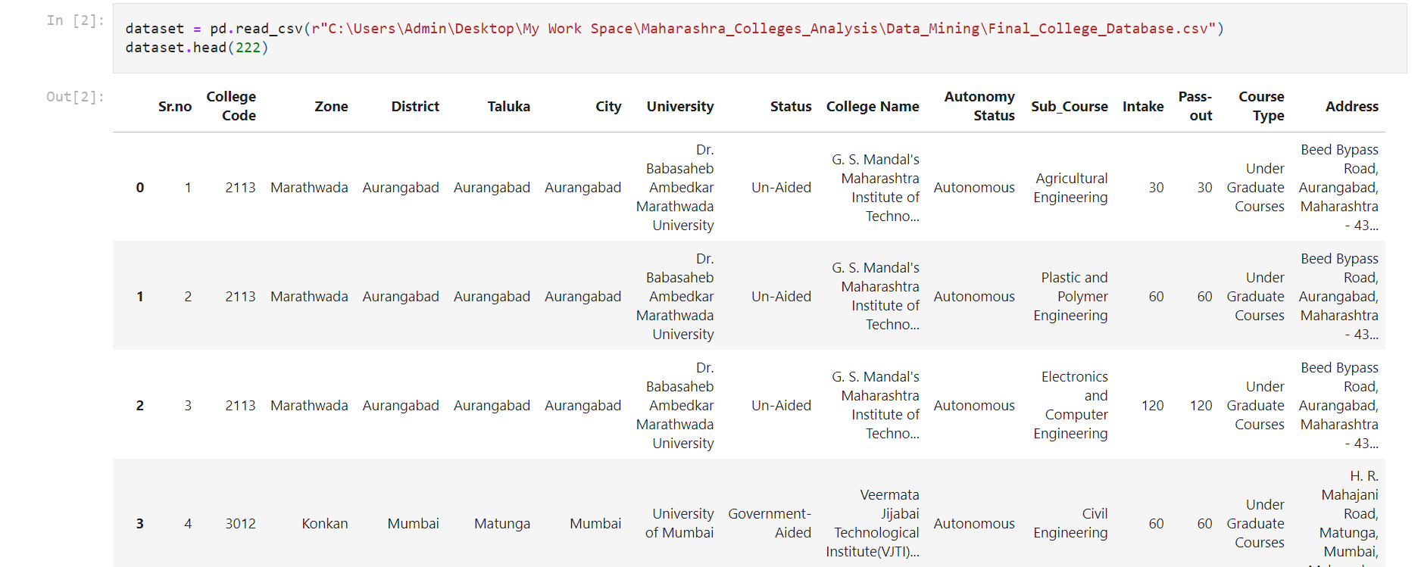
Import Libraries
Load
Dataset

Slide 16
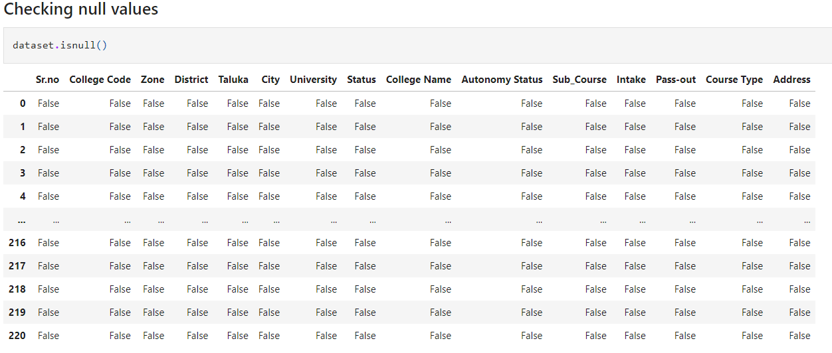
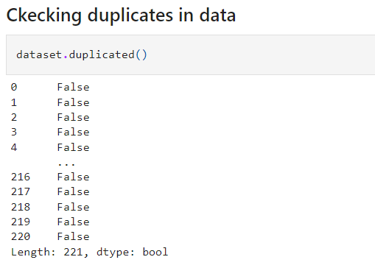
Check null Values
Check duplicate's in data

Slide 17
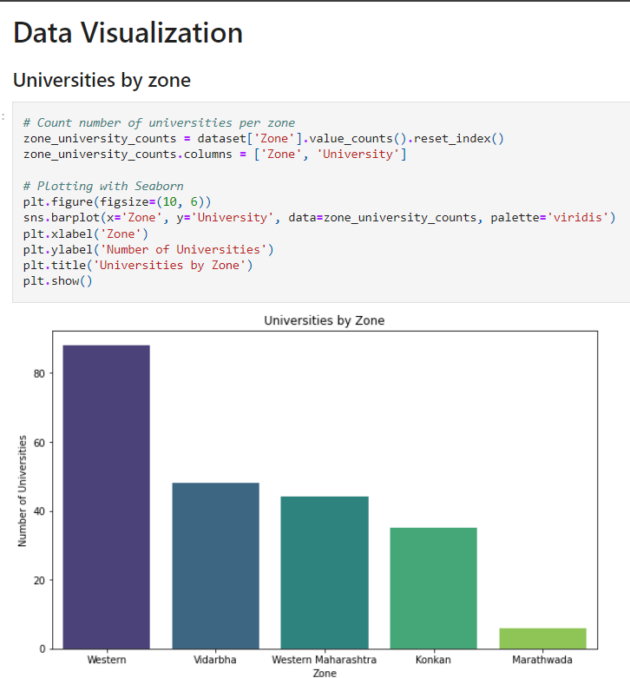
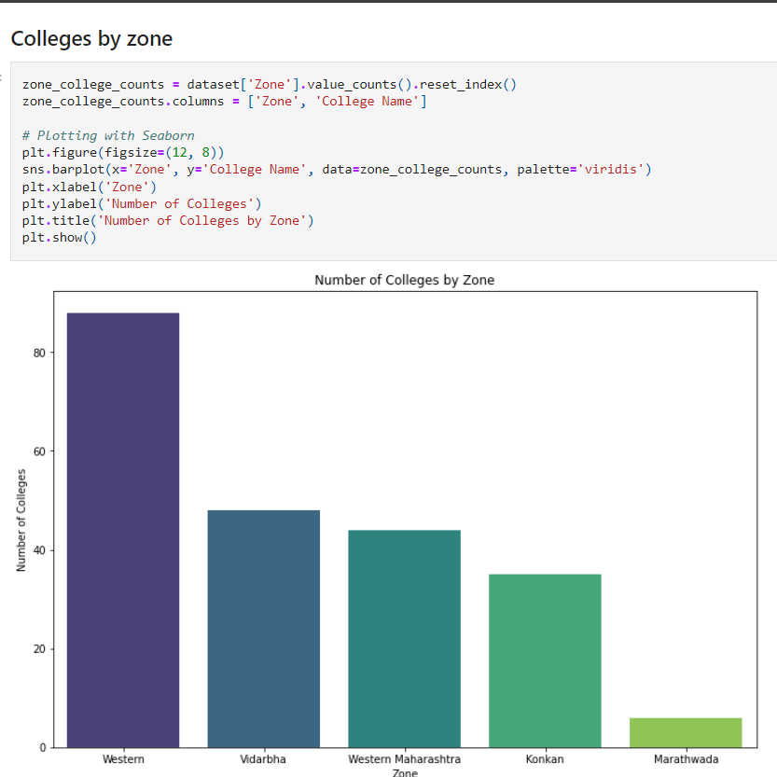
Data visualization by different category

Slide 18
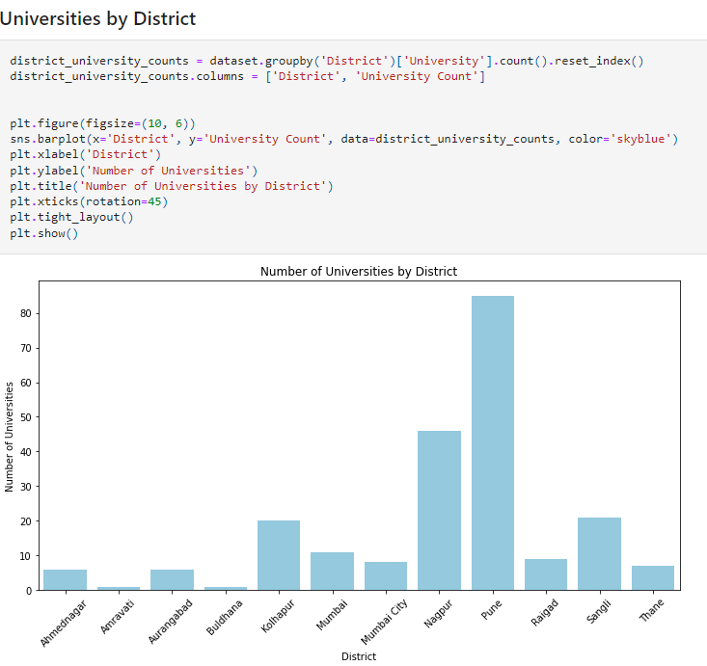
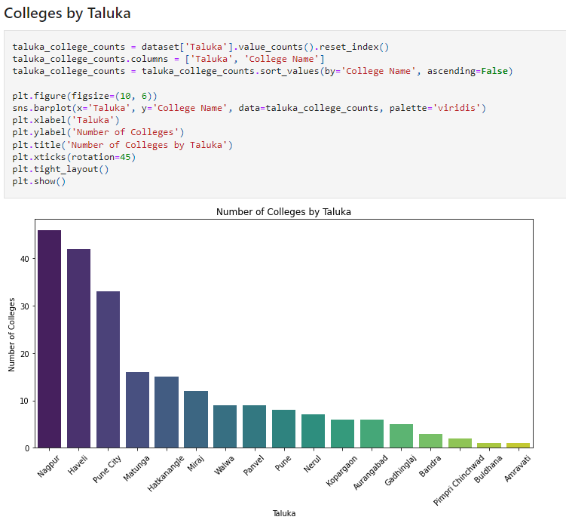
Data Load by categories

Slide 19
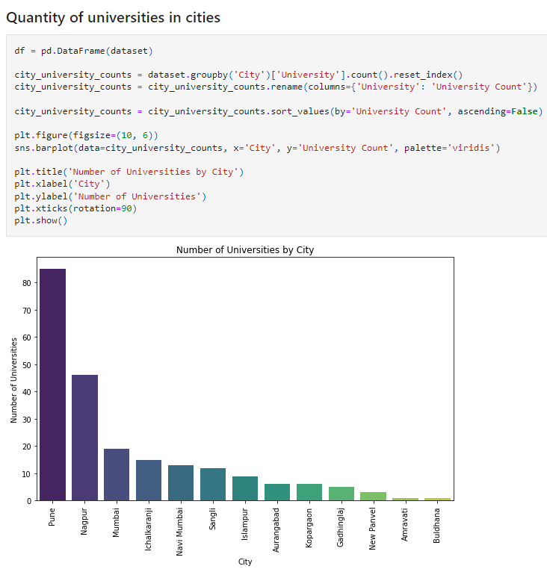
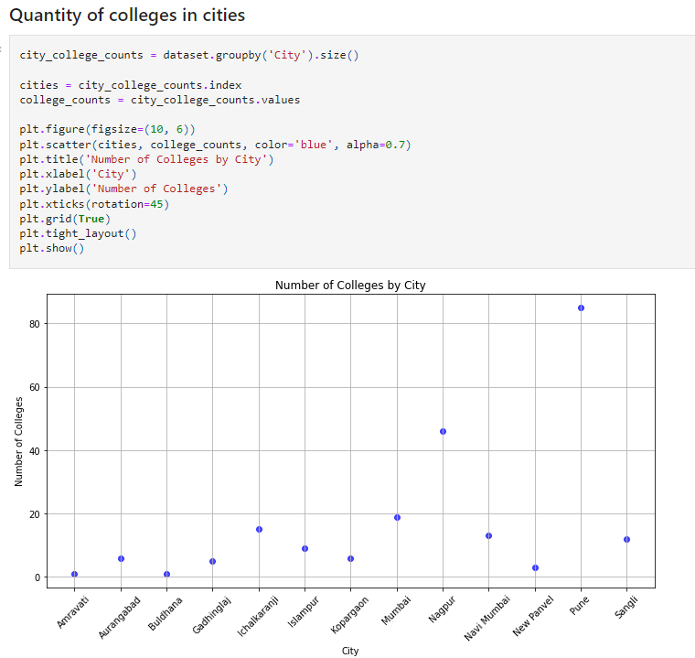
Data load Bar-plot scatter plot

Slide 20
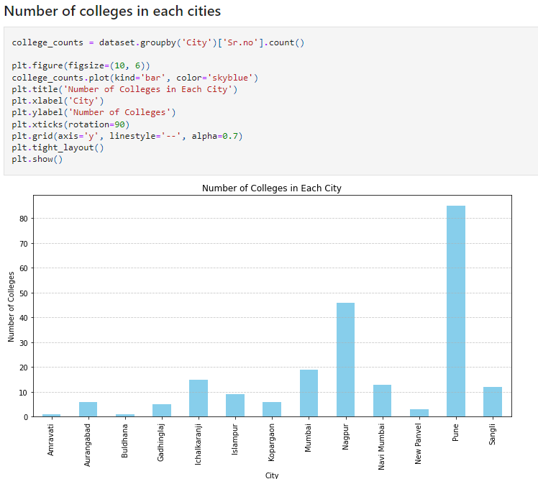
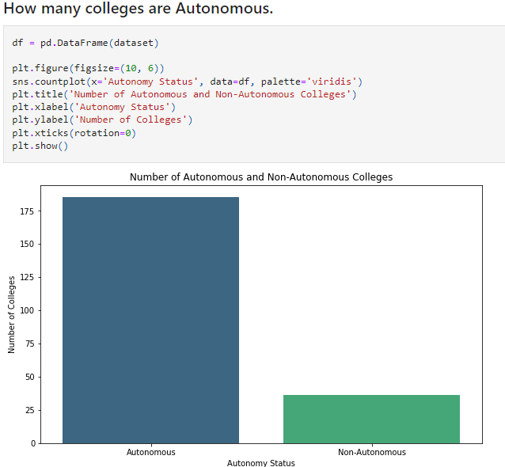

Slide 21
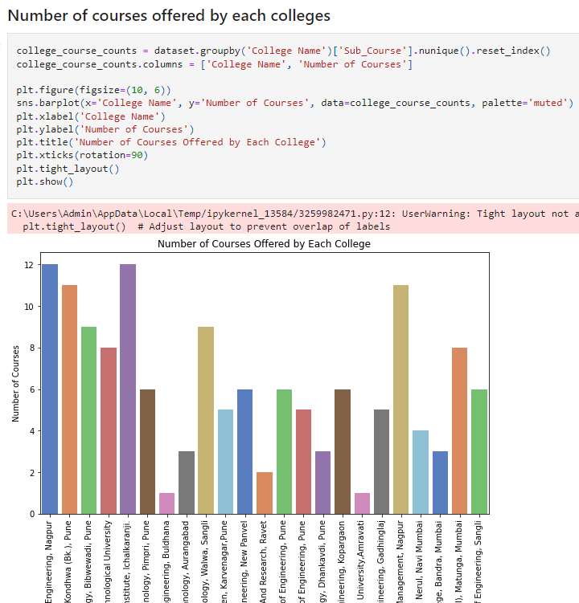

Slide 22
Thank You

